Slide 1
W4111 – Introduction to Databases Section 002, Spring 2023 Lecture 9: Module II, NoSQL, Graph DBs
© Donald F. Ferguson, 2023

Slide 2

Contents
2 | COMS W4111_002_2023_1 - Lecture 9: Module II, NoSQL, Graph DBs © Donald F. Ferguson, 2023

Slide 3
Contents

Slide 4
Module II Continued
4 | COMS W4111_002_2023_1 - Lecture 9: Module II, NoSQL, Graph DBs © Donald F. Ferguson, 2023

Slide 5

Module II – DBMS Architecture and Implementation
Overview and Reminder
5 | COMS W4111_002_2023_1 - Lecture 9: Module II, NoSQL, Graph DBs © Donald F. Ferguson, 2023

Slide 6
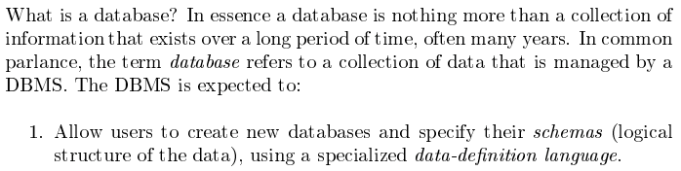
Module II – DBMS Architecture and Implementation
Covered for the relational model.
Database Systems: The Complete Book (2nd Edition) by Hector Garcia-Molina (Author), Jeffrey D. Ullman (Author), Jennifer Widom (Author)

Slide 7
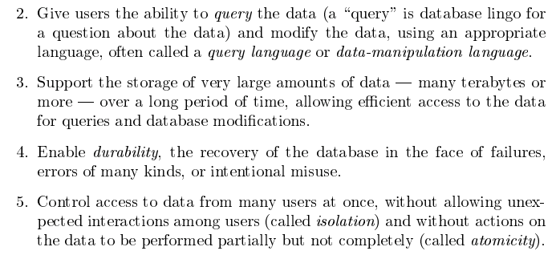
Module II – DBMS Architecture and Implementation
Database Systems: The Complete Book (2nd Edition) by Hector Garcia-Molina (Author), Jeffrey D. Ullman (Author), Jennifer Widom (Author)

Slide 8
Memory Management Buffer Management
8 | COMS W4111_002_2023_1 - Lecture 9: Module II, NoSQL, Graph DBs © Donald F. Ferguson, 2023

Slide 9
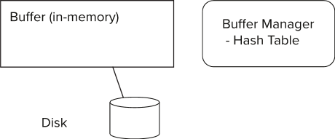
Storage Access
Blocks are units of both storage allocation and data transfer.
Database system seeks to minimize the number of block transfers between the disk and memory. We can reduce the number of disk accesses by keeping as many blocks as possible in main memory.
Buffer – portion of main memory available to store copies of disk blocks.
Buffer manager – subsystem responsible for allocating buffer space in main memory.
Notes:
9

Slide 10
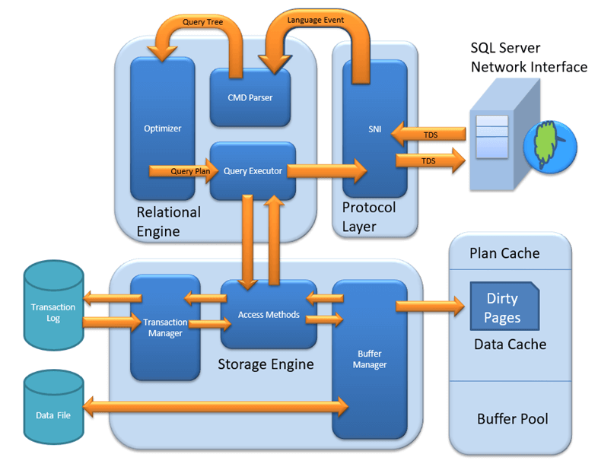
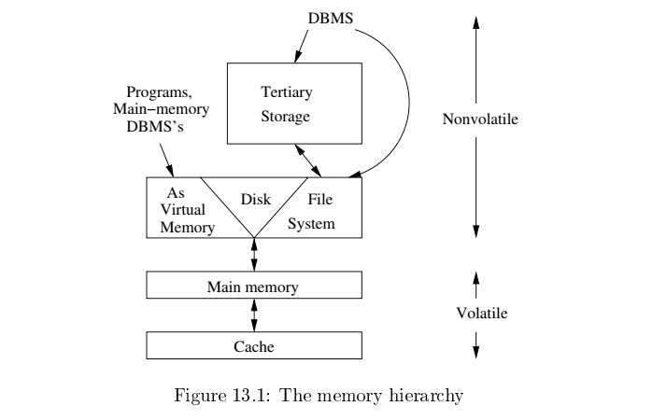
Architecture
OS allocates percent of main memory to running applications.
Allocation based on demand and workload importance.
OS normally manages page replacement.
OS controls the replacement for the buffer pool because of ability to predict access.

Slide 11
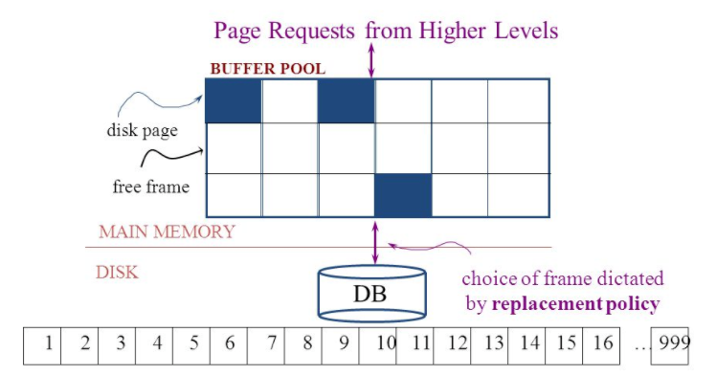
The Logical Concept
The DBMS and queries can only manipulate in-memory blocks and records.
A very, very, very small fraction of all blocks fit in memory.

Slide 12
Buffer Manager
Programs call on the buffer manager when they need a block from disk.
If the block is already in the buffer, buffer manager returns the address of the block in main memory
If the block is not in the buffer, the buffer manager
Allocates space in the buffer for the block
Replacing (throwing out) some other block, if required, to make space for the new block.
Replaced block written back to disk only if it was modified since the most recent time that it was written to/fetched from the disk.
Reads the block from the disk to the buffer, and returns the address of the block in main memory to requester.
Notes:
12

Slide 13
Buffer Manager
Buffer replacement strategy (details coming up!)
Pinned block: memory block that is not allowed to be written back to disk
Pin done before reading/writing data from a block
Unpin done when read /write is complete
Multiple concurrent pin/unpin operations possible
Keep a pin count, buffer block can be evicted only if pin count = 0
Shared and exclusive locks on buffer
Needed to prevent concurrent operations from reading page contents as they are moved/reorganized, and to ensure only one move/reorganize at a time
Readers get shared lock, updates to a block require exclusive lock
Locking rules:
Only one process can get exclusive lock at a time
Shared lock cannot be concurrently with exclusive lock
Multiple processes may be given shared lock concurrently

Slide 14
Buffer-Replacement Policies
Most operating systems replace the block least recently used (LRU strategy)
Idea behind LRU – use past pattern of block references as a predictor of future references
LRU can be bad for some queries
Queries have well-defined access patterns (such as sequential scans), and a database system can use the information in a user’s query to predict future references
Mixed strategy with hints on replacement strategy provided by the query optimizer is preferable
Example of bad access pattern for LRU: when computing the join of 2 relations r and s by a nested loops
for each tuple tr of r do for each tuple ts of s do if the tuples tr and ts match …
Notes:
14

Slide 15
Buffer-Replacement Policies (Cont.)
Toss-immediate strategy – frees the space occupied by a block as soon as the final tuple of that block has been processed
Most recently used (MRU) strategy – system must pin the block currently being processed. After the final tuple of that block has been processed, the block is unpinned, and it becomes the most recently used block.
Buffer manager can use statistical information regarding the probability that a request will reference a particular relation
E.g., the data dictionary is frequently accessed. Heuristic: keep data-dictionary blocks in main memory buffer
Operating system or buffer manager may reorder writes
Can lead to corruption of data structures on disk
E.g., linked list of blocks with missing block on disk
File systems perform consistency check to detect such situations
Careful ordering of writes can avoid many such problems
Notes:
15

Slide 16
Replacement Policy
The replacement policy is one of the most important factors in database management system implementation and configuration.
A very simple, introductory explanation is (https://en.wikipedia.org/wiki/Cache_replacement_policies).
There are a lot of possible policies.
The most efficient caching algorithm would be to always discard the information that will not be needed for the longest time in the future. This optimal result is referred to as Bélády's optimal algorithm/simply optimal replacement policy or the clairvoyant algorithm.
All implementable policies are an attempt to approximate knowledge of the future based on knowledge of the past.
Least Recently Used is based on the simplest assumption
The information that will not be needed for the longest time.
Is the information that has not been accessed for the longest time.

Slide 17
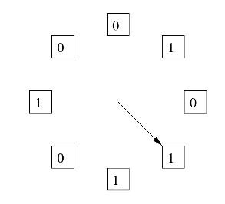
The “Clock Algorithm”
LRU is (perceived to be) expensive
Maintain timestamp for each block.
Update and resort blocks on access.
The “Clock Algorithm” is a less expensive approximation.
Arrange the frames (places blocks can go) into a logical circle like the seconds on a clock face.
Each frame is marked 0 or 1.
Set to 1 when block added to frame.
Or when application accesses a block in frame.
Replacement choice
Sweep second hand clockwise one frame at a time.
If bit is 0, choose for replacement.
If bit is 1, set bit to zero and go to next frame.
The basic idea is. On a clock face
If the second hand is currently at 27 seconds.
The 28 second tick mark is “the least recently touched mark.”

Slide 18
Replacement Algorithm
The algorithms are more sophisticated in the real world, e.g.
“Scans” are common, e.g. go through a large query result in order (will be more clear when discussing cursors).
The engine knows the current position in the result set.
Uses the sort order to determine which records will be accessed soon.
Tags those blocks as not replaceable.
(A form of clairvoyance).
Not all users/applications are equally “important.”
Classify users/applications into priority 1, 2 and 3.
Sub-allocate the buffer pool into pools P1, P2 and P3.
Apply LRU within pools and adjust pool sizes based on relative importance.
This prevents
A high access rate, low-priority application from taking up a lot of frames
Result in low access, high priority applications not getting buffer hits.

Slide 19
Optimization of Disk Block Access (Cont.)
Buffer managers support forced output of blocks for the purpose of recovery (more in Chapter 19)
Nonvolatile write buffers speed up disk writes by writing blocks to a non-volatile RAM or flash buffer immediately
Writes can be reordered to minimize disk arm movement
Log disk – a disk devoted to writing a sequential log of block updates
Used exactly like nonvolatile RAM
Write to log disk is very fast since no seeks are required
Journaling file systems write data in-order to NV-RAM or log disk
Reordering without journaling: risk of corruption of file system data

Slide 20
Indexes
20 | COMS W4111_002_2023_1 - Lecture 9: Module II, NoSQL, Graph DBs © Donald F. Ferguson, 2023

Slide 21
Basic Concepts
Indexing mechanisms used to speed up access to desired data.
E.g., author catalog in library
Search Key - attribute to set of attributes used to look up records in a file.
An index file consists of records (called index entries) of the form
Index files are typically much smaller than the original file
Two basic kinds of indices:
Ordered indices: search keys are stored in sorted order
Hash indices: search keys are distributed uniformly across “buckets” using a “hash function”.
search-key
pointer

Slide 22
Ordered Indices
In an ordered index, index entries are stored sorted on the search key value.
Clustering index: in a sequentially ordered file, the index whose search key specifies the sequential order of the file.
Also called primary index
The search key of a primary index is usually but not necessarily the primary key.
Secondary index: an index whose search key specifies an order different from the sequential order of the file. Also called nonclustering index.
Index-sequential file: sequential file ordered on a search key, with a clustering index on the search key.

Slide 23
Dense Index Files
Dense index — Index record appears for every search-key value in the file.
E.g. index on ID attribute of instructor relation

Slide 24
Dense Index Files (Cont.)
Dense index on dept_name, with instructor file sorted on dept_name

Slide 25
Sparse Index Files
Sparse Index: contains index records for only some search-key values.
Applicable when records are sequentially ordered on search-key
To locate a record with search-key value K we:
Find index record with largest search-key value < K
Search file sequentially starting at the record to which the index record points

Slide 26
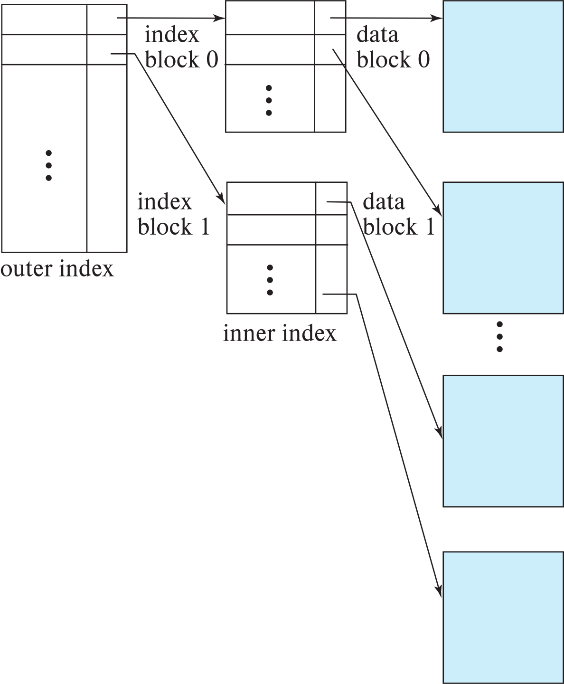
Sparse Index Files (Cont.)
Compared to dense indices:
Less space and less maintenance overhead for insertions and deletions.
Generally slower than dense index for locating records.
Good tradeoff:
for clustered index: sparse index with an index entry for every block in file, corresponding to least search-key value in the block.
For unclustered index: sparse index on top of dense index (multilevel index)

Slide 27
Secondary Indices Example
Secondary index on salary field of instructor
Index record points to a bucket that contains pointers to all the actual records with that particular search-key value.
Secondary indices have to be dense

Slide 28
Clustering vs Nonclustering Indices
Indices offer substantial benefits when searching for records.
BUT: indices imposes overhead on database modification
when a record is inserted or deleted, every index on the relation must be updated
When a record is updated, any index on an updated attribute must be updated
Sequential scan using clustering index is efficient, but a sequential scan using a secondary (nonclustering) index is expensive on magnetic disk
Each record access may fetch a new block from disk
Each block fetch on magnetic disk requires about 5 to 10 milliseconds

Slide 29
Indices on Multiple Keys
Composite search key
E.g., index on instructor relation on attributes (name, ID)
Values are sorted lexicographically
E.g. (John, 12121) < (John, 13514) and (John, 13514) < (Peter, 11223)
Can query on just name, or on (name, ID)
(nameLast, nameFirst, birthyear)
nameLast [nameLast = “Ferguson”] [nameLast like “Fer%”]
nameLast, nameFirst
nameLast, nameFirst, birthyear
NOT and index on
nameFirst, nameLast
birthyear
nameLast like [%er%]

Slide 30
B⁺-Tree Index Files
Disadvantage of indexed-sequential files
Performance degrades as file grows, since many overflow blocks get created.
Periodic reorganization of entire file is required.
Advantage of B⁺-tree index files:
Automatically reorganizes itself with small, local, changes, in the face of insertions and deletions.
Reorganization of entire file is not required to maintain performance.
(Minor) disadvantage of B⁺-trees:
Extra insertion and deletion overhead, space overhead.
Advantages of B⁺-trees outweigh disadvantages
B⁺-trees are used extensively

Slide 31
Example of B⁺-Tree

Slide 32
B⁺-Tree Index Files (Cont.)
A B⁺-tree is a rooted tree satisfying the following properties:
All paths from root to leaf are of the same length
Each node that is not a root or a leaf has between ⎡n/2⎤ and n children.
A leaf node has between ⎡(n–1)/2⎤ and n–1 values
Special cases:
If the root is not a leaf, it has at least 2 children.
If the root is a leaf (that is, there are no other nodes in the tree), it can have between 0 and (n–1) values.

Slide 33
B⁺-Tree Node Structure
Typical node
K_{i} are the search-key values
P_{i} are pointers to children (for non-leaf nodes) or pointers to records or buckets of records (for leaf nodes).
The search-keys in a node are ordered
K₁ < K₂ < K₃ < . . . < K_{n–1}
(Initially assume no duplicate keys, address duplicates later)

Slide 34
Leaf Nodes in B⁺-Trees
Properties of a leaf node:
For i = 1, 2, . . ., n–1, pointer P_{i} points to a file record with search-key value K_{i},
If L_{i}, L_{j} are leaf nodes and i < j, L_{i}’s search-key values are less than or equal to L_{j}’s search-key values
P_{n} points to next leaf node in search-key order

Slide 35
Non-Leaf Nodes in B⁺-Trees
Non leaf nodes form a multi-level sparse index on the leaf nodes. For a non-leaf node with m pointers:
All the search-keys in the subtree to which P₁ points are less than K₁
For 2 ≤ i ≤ n – 1, all the search-keys in the subtree to which P_{i} points have values greater than or equal to K_{i–1} and less than K_{i}
All the search-keys in the subtree to which P_{n} points have values greater than or equal to K_{n–1}
General structure

Slide 36
Example of B⁺-tree
B⁺-tree for instructor file (n = 6)
Leaf nodes must have between 3 and 5 values (⎡(n–1)/2⎤ and n –1, with n = 6).
Non-leaf nodes other than root must have between 3 and 6 children (⎡(n/2⎤ and n with n =6).
Root must have at least 2 children.

Slide 37
Observations about B⁺-trees
Since the inter-node connections are done by pointers, “logically” close blocks need not be “physically” close.
The non-leaf levels of the B⁺-tree form a hierarchy of sparse indices.
The B⁺-tree contains a relatively small number of levels
Level below root has at least 2* ⎡n/2⎤ values
Next level has at least 2* ⎡n/2⎤ * ⎡n/2⎤ values
.. etc.
If there are K search-key values in the file, the tree height is no more than ⎡ log_{⎡n/2⎤}(K)⎤
thus searches can be conducted efficiently.
Insertions and deletions to the main file can be handled efficiently, as the index can be restructured in logarithmic time (as we shall see).

Slide 38
Show the Simulator
https://www.cs.usfca.edu/~galles/visualization/BPlusTree.html

Slide 39
Hashing

Slide 40
Static Hashing
A bucket is a unit of storage containing one or more entries (a bucket is typically a disk block).
we obtain the bucket of an entry from its search-key value using a hash function
Hash function h is a function from the set of all search-key values K to the set of all bucket addresses B.
Hash function is used to locate entries for access, insertion as well as deletion.
Entries with different search-key values may be mapped to the same bucket; thus entire bucket has to be searched sequentially to locate an entry.
In a hash index, buckets store entries with pointers to records
In a hash file-organization buckets store records

Slide 41
Handling of Bucket Overflows (Cont.)
Overflow chaining – the overflow buckets of a given bucket are chained together in a linked list.
Above scheme is called closed addressing (also called closed hashing or open hashing depending on the book you use)
An alternative, called open addressing (also called open hashing or closed hashing depending on the book you use) which does not use over- flow buckets, is not suitable for database applications.

Slide 42
Example of Hash File Organization
Hash file organization of instructor file, using dept_name as key.

Slide 43
Deficiencies of Static Hashing
In static hashing, function h maps search-key values to a fixed set of B of bucket addresses. Databases grow or shrink with time.
If initial number of buckets is too small, and file grows, performance will degrade due to too much overflows.
If space is allocated for anticipated growth, a significant amount of space will be wasted initially (and buckets will be underfull).
If database shrinks, again space will be wasted.
One solution: periodic re-organization of the file with a new hash function
Expensive, disrupts normal operations
Better solution: allow the number of buckets to be modified dynamically.

Slide 44
Show the Simulator
http://iswsa.acm.org/mphf/openDSAPerfectHashAnimation/perfectHashAV.html
https://opendsa-server.cs.vt.edu/ODSA/AV/Development/hashAV.html

Slide 45
NoSQL
45 |Introduction to Databases (S22): Lecture 9: NoSQL (I), Module II (I) © Donald F. Ferguson, 2022

Slide 46
Reminder
46 | COMS W4111_002_2023_1 - Lecture 9: Module II, NoSQL, Graph DBs © Donald F. Ferguson, 2023

Slide 47
Simplistic Classification (https://medium.com/swlh/4-types-of-nosql-databases-d88ad21f7d3b)
Relational is the foundational model.
We will see OLAP in a future lecture.
Subject of this lecture and part of HW4
We covered graphs and examples.

Slide 48
Graph Databases
48 | COMS W4111_002_2023_1 - Lecture 9: Module II, NoSQL, Graph DBs © Donald F. Ferguson, 2023

Slide 49
Graph Database
Exactly what it sounds like
Two core types
Node
Edge (link)
Nodes and Edges have
Label(s) = “Kind”
Properties (free form)
Query is of the form
p1(n)-p2(e)-p3(m)
n, m are nodes; e is an edge
p1, p2, p3 are predicates on labels
N->R->M

Slide 50
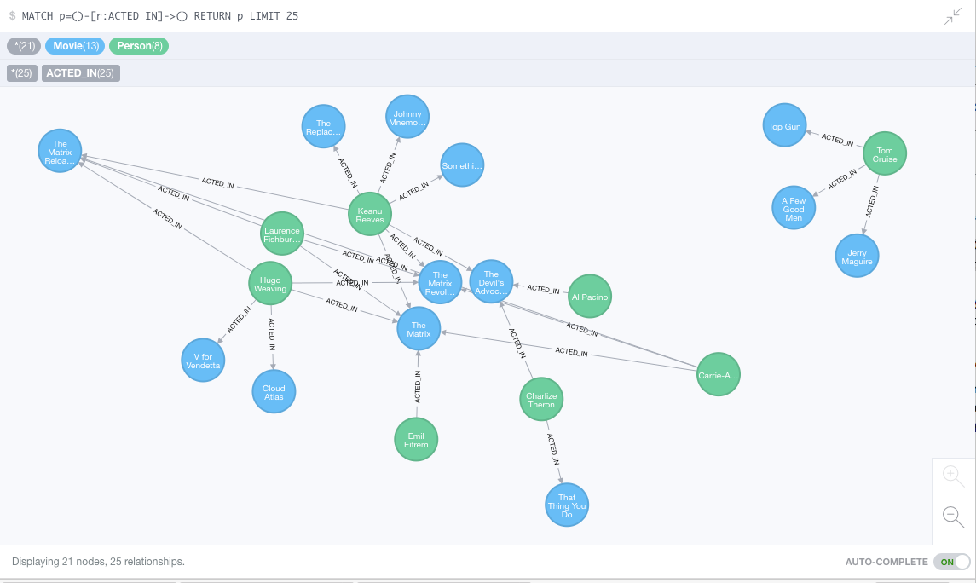
Neo4J Graph Query

Slide 51
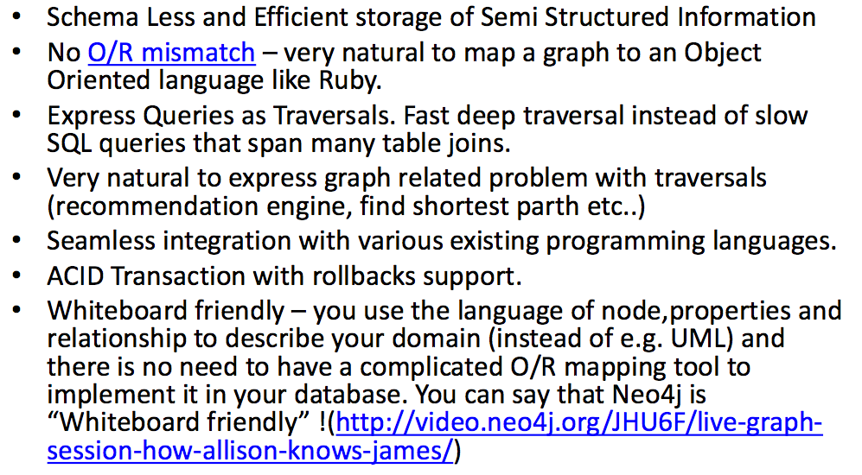
Why Graph Databases?

Slide 52
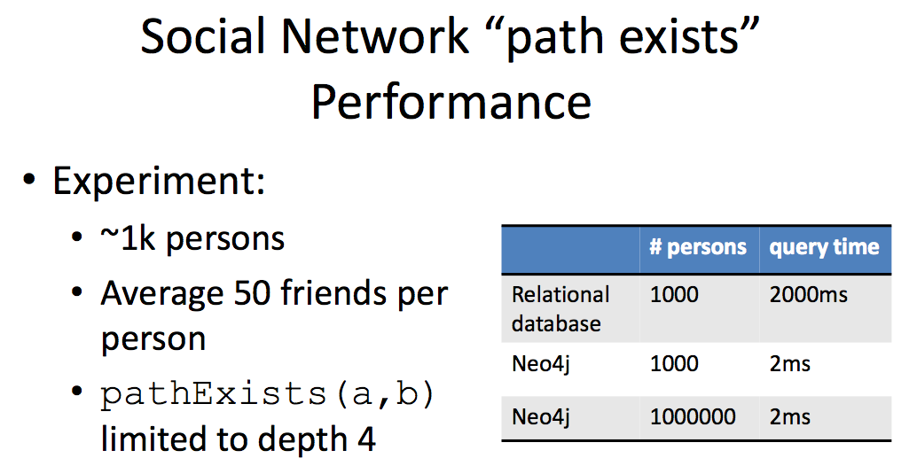
Graph databases are
Extremely fast for some queries and data models.
Implement a language that vastly simplifies writing queries.

Slide 53
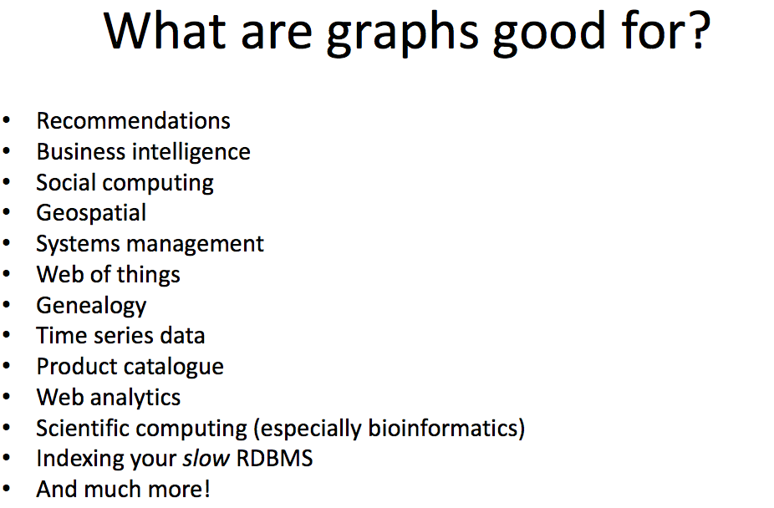

Slide 54
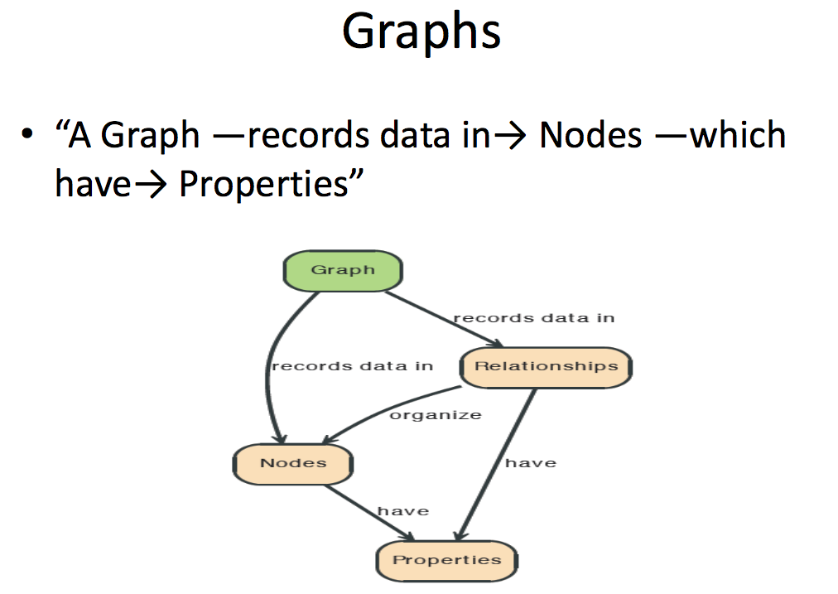

Slide 55
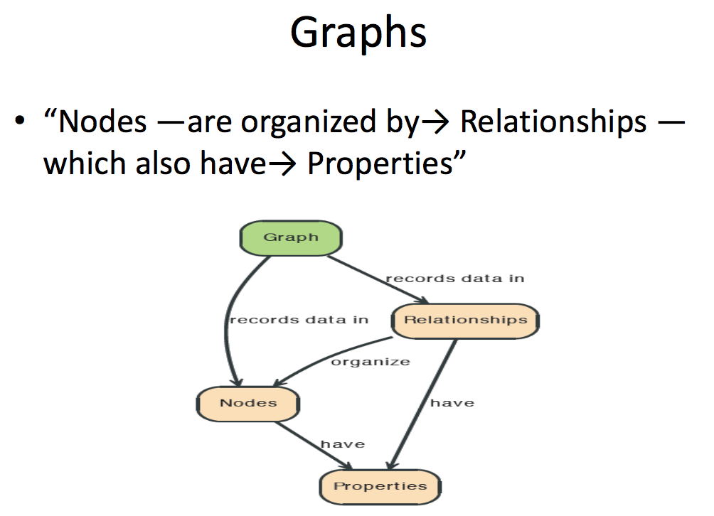

Slide 56
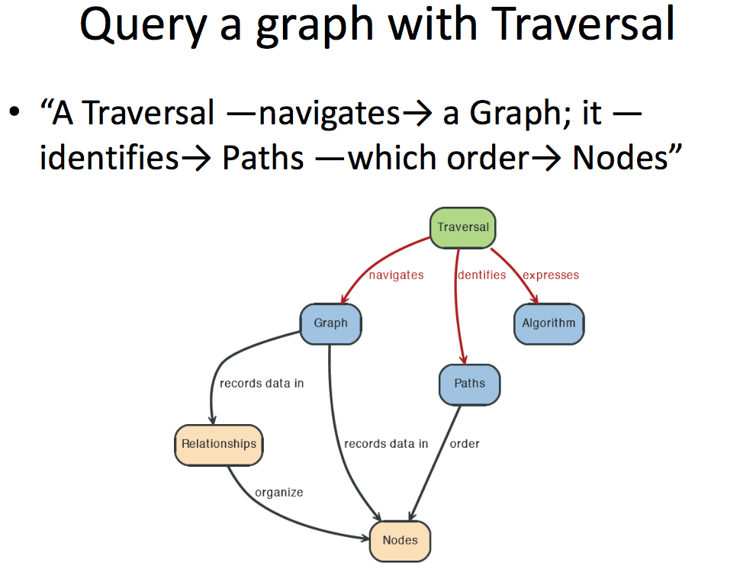

Slide 57
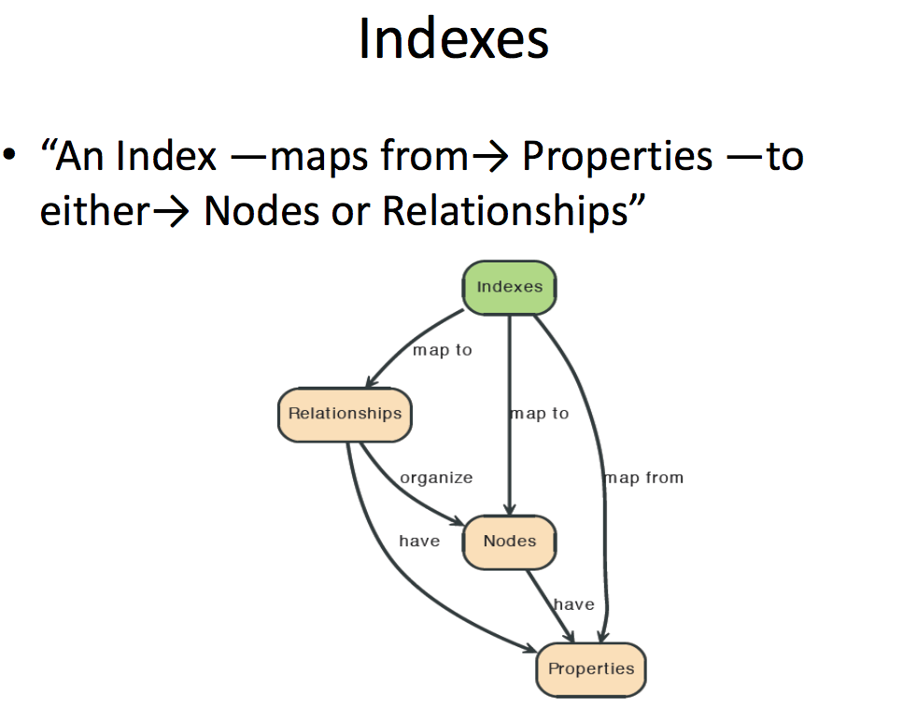

Slide 58
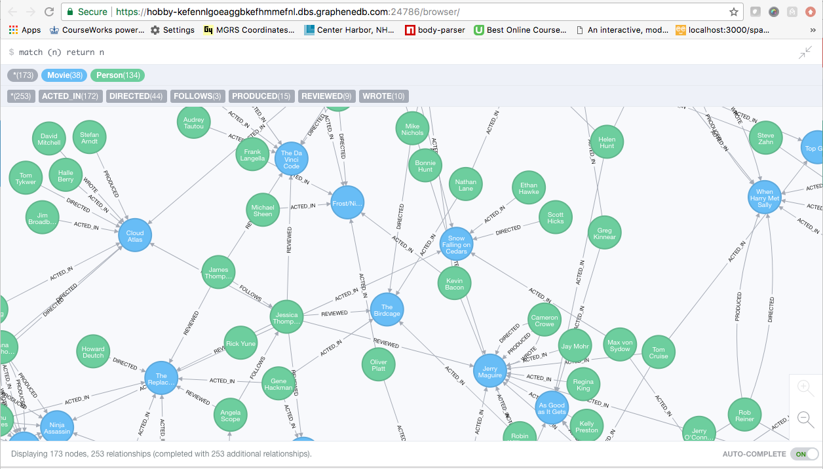
A Graph Database (Sample)

Slide 59
Neo4J Graph Query
Who acted in which movies?

Slide 60
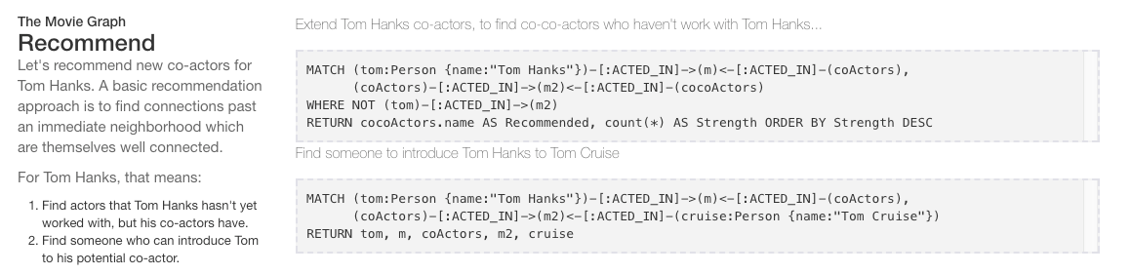
Big Deal. That is just a JOIN.
Yup. But that is simple.
Try writing the queries below in SQL.

Slide 61
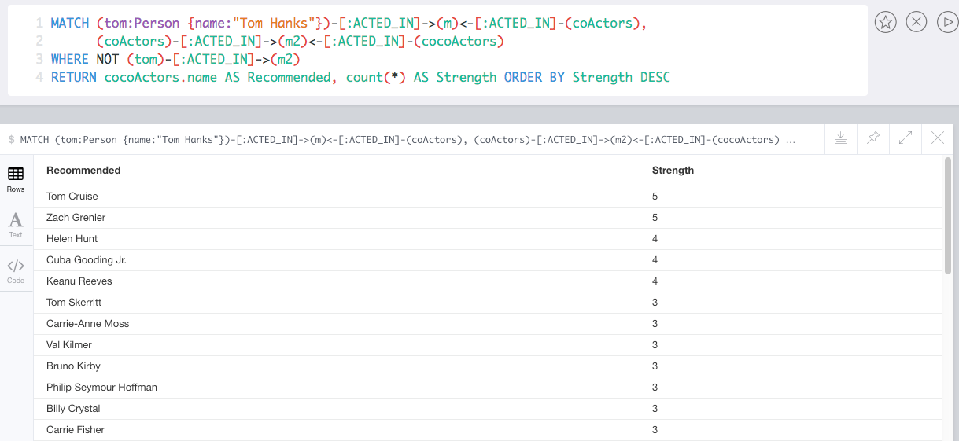
Recommend

Slide 62
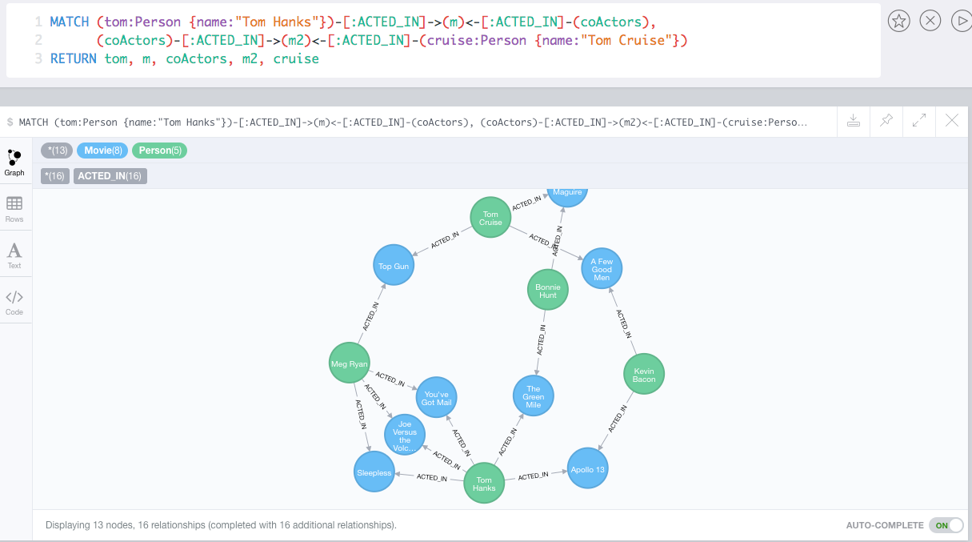
Which actors have worked with both Tom Hanks and
Tom Cruise?

Slide 63
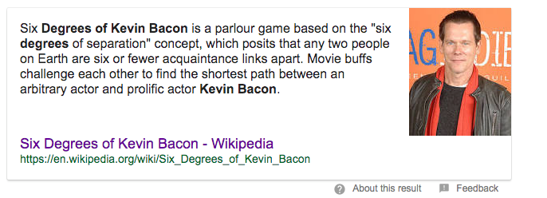
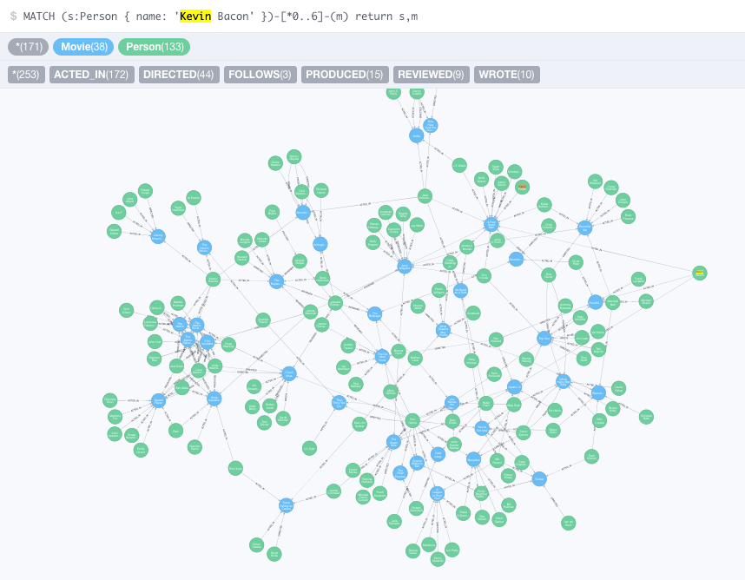


Slide 64
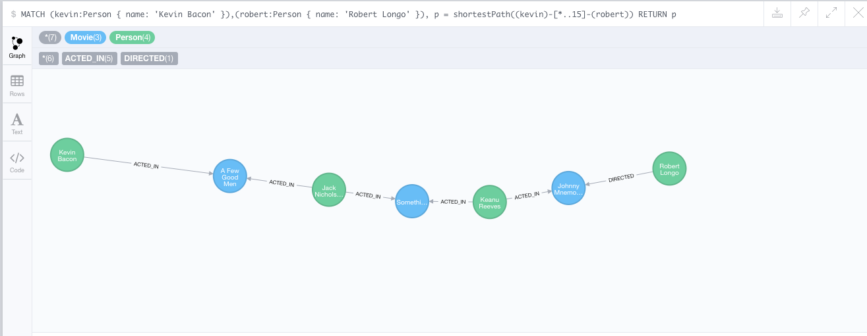
How do you get from Kevin Bacon to
Robert Longo?

